Slide 1
Why Futuristic Premillennialism?
October 17, 2021

Slide 2
Familiar with Terms
Millennial, Millennialism?
from the Latin “mille” meaning “1000”
from the Greek “chilia eta” meaning “1000 years”
“chilia eta” six times in Revelation 20 (2,3,4,5,6,7)

Slide 3
Revelation 20:1-7
1 Then I saw an angel coming down from heaven, holding the key of the abyss and a great chain in his hand. 2 And he laid hold of the dragon, the serpent of old, who is the devil and Satan, and bound him for a thousand years; 3 and he threw him into the abyss, and shut it and sealed it over him, so that he would not deceive the nations any longer, until the thousand years were completed; after these things he must be released for a short time. 4 Then I saw thrones, and they sat on them, and judgment was given to them. And I saw the souls of those who had been beheaded because of their testimony of Jesus and because of the word of God, and those who had not worshiped the beast or his image, and had not received the mark on their forehead and on their hand; and they came to life and reigned with Christ for a thousand years. 5 The rest of the dead did not come to life until the thousand years were completed. This is the first resurrection. 6 Blessed and holy is the one who has a part in the first resurrection; over these the second death has no power, but they will be priests of God and of Christ and will reign with Him for a thousand years. 7 When the thousand years are completed, Satan will be released from his prison…

Slide 4
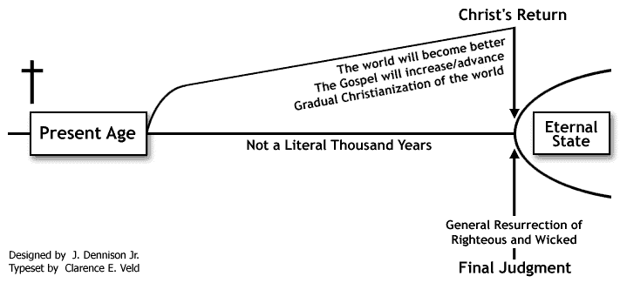
Postmillennialism

Slide 5
Amillennialism

Slide 6
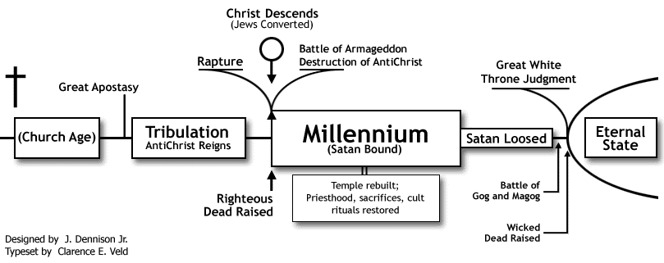
Historic Premillennialism

Slide 7
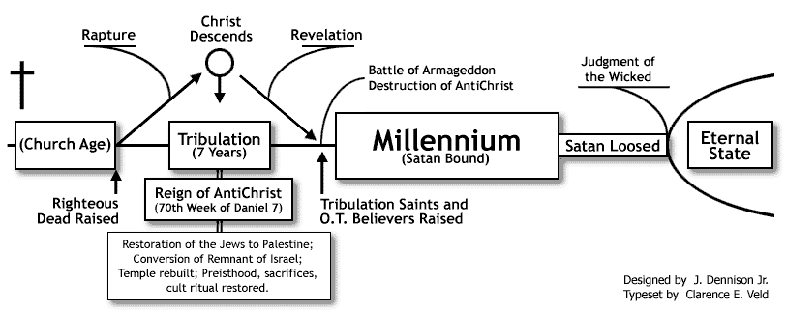
Futuristic Premillennialism

Slide 8
Futuristic Premillennialism

Slide 9
A consistent hermeneutic (method of interpretation)
Takes the biblical text at face value (if that is what it says, that is what it means).
Interprets the biblical text in context
Recognizes symbolic language/speech figures and the reality they express.
Uses clear texts to interpret the unclear/more difficult.
Allows for the progress of revelation without inappropriately altering the meaning of previous revelation.
Allows for double fulfillment of prophecies (near/far)-for example, two advents of Christ in Isaiah 61-without resorting to double meanings in a primary sense.

Slide 10
Isaiah 61:1-2
1 The Spirit of the Lord God is upon me, Because the Lord has anointed me to bring good news to the afflicted; He has sent me to bind up the brokenhearted, to proclaim liberty to captives And freedom to prisoners; 2 To proclaim the favorable year of the Lord and the day of vengeance of our God…

Slide 11
Luke 4:16-21
16 And He came to Nazareth, where He had been brought up; and as was His custom, He entered the synagogue on the Sabbath, and stood up to read. 17 And the book of the prophet Isaiah was handed to Him. And He opened the book and found the place where it was written, 18 "THE SPIRIT OF THE LORD IS UPON ME, BECAUSE HE ANOINTED ME TO PREACH THE GOSPEL TO THE POOR. HE HAS SENT ME TO PROCLAIM RELEASE TO THE CAPTIVES, AND RECOVERY OF SIGHT TO THE BLIND, TO SET FREE THOSE WHO ARE OPPRESSED, 19 TO PROCLAIM THE FAVORABLE YEAR OF THE LORD." 20 And He closed the book, gave it back to the attendant and sat down; and the eyes of all in the synagogue were fixed on Him. 21 And He began to say to them, "Today this Scripture has been fulfilled in your hearing."

Slide 12
OT Prophecies fulfilled in OT History
Genesis 17:6
from Abraham would come kings
Daniel 2
world kingdoms
Habakkuk
in regard to Babylon and Judah

Slide 13
OT Prophecies fulfilled at Christ First Coming
Genesis 49:10
Tribe of Judah
Micah 5:2
born in Bethlehem
Psalm 22
Crucifixion

Slide 14
Interesting Admissions
Floyd E. Hamiltlon in The Basis of the Millennial Faith wrote;
“Now we must frankly admit that a literal interpretation of the Old Testament prophecies gives us just such a picture of an earthly reign of the Messiah as the premillennialist pictures.”
Loraine Boettner in The Meaning of the Millennium wrote;
“It is generally agreed that if the prophecies are taken literally they do foretell a restoration of the nation of Israel in the land of Palestine with the Jews having a prominent place in that kingdom and ruling over the nations.”

Slide 15
How did a 1st Century Jew Understand the Coming of Messiah?
A season of extreme tribulation would prevail prior to Messiah’s arrival.
In the midst of this upheaval, Elijah would arrive as the forerunner and announcer of Messiah.
Messiah would then come to earth.
The nations would rise up against Messiah.
A coalition of nations would be defeated and destroyed by Messiah.
Jerusalem would be reoccupied and rebuilt.
The Jews scattered throughout the world would return to Jerusalem.
Israel would become the capitol of the world.
A time of peace and prosperity would be inaugurated.

Slide 16
II. An impartial exegesis
Three questions to answer with regard to a text like Revelation 20 –
Is this time period yet future or has it already been fulfilled?
Is this period actually one thousand years in length or does the term represent another length of time?
How has the “one thousand” of Revelation 20 been interpreted in the past?

Slide 17
Revelation 20:1-7
1 Then I saw an angel coming down from heaven, holding the key of the abyss and a great chain in his hand. 2 And he laid hold of the dragon, the serpent of old, who is the devil and Satan, and bound him for a thousand years; 3 and he threw him into the abyss, and shut it and sealed it over him, so that he would not deceive the nations any longer, until the thousand years were completed; after these things he must be released for a short time. 4 Then I saw thrones, and they sat on them, and judgment was given to them. And I saw the souls of those who had been beheaded because of their testimony of Jesus and because of the word of God, and those who had not worshiped the beast or his image, and had not received the mark on their forehead and on their hand; and they came to life and reigned with Christ for a thousand years. 5 The rest of the dead did not come to life until the thousand years were completed. This is the first resurrection. 6 Blessed and holy is the one who has a part in the first resurrection; over these the second death has no power, but they will be priests of God and of Christ and will reign with Him for a thousand years. 7 When the thousand years are completed, Satan will be released from his prison…

Slide 18
Is Satan Bound Now?
Satan still entices men to lie – Acts 5:3
He blinds the minds of believers to the Gospel – 2 Corinthians 4:4
He disguises himself as an angel of light to deceive the church – 2 Corinthians 11:2-3, 13-15
He hinders the ministers of God – I Thessanlonians 2:18
He roams about the earth seeking someone to devour – 1 Peter 5:8

Slide 19
Numbers in the Book of Revelation
Seven churches and seven angels – Revelation 1
Twelve tribes and twelve apostles refer to actual historical numbers – (21:12, 14)
Ten days – (2:10)
Five months – (9:5)
One-third of mankind – (9:15)
Two witnesses – (11:3)
Forty-two months – (11:2)
1,260 days – (11:3)
Twelve stars – (12:1)
Ten horns – (13:1)
Two hundred miles – (14:20)
Three demons – (16:13)
Five fallen kings – (17:9-10)

Slide 20
III. God’s Unconditional Covenants
There are six clearly defined covenants:
Noahic (Genesis 6:18; 9:8-17)
Abrahamic (Genesis 15:1-21; 17:1-22)
Mosaic (Exodus 19 and 20)
Palestinian (Deuteronomy 30)
Davidic (2 Samuel 7)
New (Jeremiah 31)

Slide 21
IV. God’s Uncompromising Promises
Jeremiah 24:5-7
5 Thus says the Lord God of Israel, “Like these good figs, so I will regard as good the captives of Judah, whom I have sent out of this place into the land of the Chaldeans. 6 For I will set My eyes on them for good, and I will bring them again to this land; and I will build them up and not overthrow them, and I will plant them and not pluck them up. 7 'I will give them a heart to know Me, for I am the Lord; and they will be My people, and I will be their God, for they will return to Me with their whole heart.”

Slide 22
IV. God’s Uncompromising Promises
Jeremiah 31:11-12
11 For the Lord has ransomed Jacob And redeemed him from the hand of him who was stronger than he. 12 They will come and shout for joy on the height of Zion, And they will be radiant over the bounty of the Lord — Over the grain and the new wine and the oil, And over the young of the flock and the herd; And their life will be like a watered garden, And they will never languish again.

Slide 23
IV. God’s Uncompromising Promises
Ezekiel 34:28-29
28 They will no longer be a prey to the nations, and the beasts of the earth will not devour them; but they will live securely, and no one will make them afraid. 29 I will establish for them a renowned planting place, and they will not again be victims of famine in the land, and they will not endure the insults of the nations anymore.

Slide 24
IV. God’s Uncompromising Promises
Ezekiel 37:24-28
24 My servant David will be king over them, and they will all have one shepherd; and they will walk in My ordinances and keep My statutes and observe them. 25 They will live on the land that I gave to Jacob My servant, in which your fathers lived; and they will live on it, they, and their sons and their sons' sons, forever; and David My servant will be their prince forever. 26 I will make a covenant of peace with them; it will be an everlasting covenant with them. And I will place them and multiply them, and will set My sanctuary in their midst forever. 27 My dwelling place also will be with them; and I will be their God, and they will be My people. 28 "And the nations will know that I am the Lord who sanctifies Israel, when My sanctuary is in their midst forever.

Slide 25
IV. God’s Uncompromising Promises
Jeremiah 24:5-7
5 Thus says the Lord God of Israel, “Like these good figs, so I will regard as good the captives of Judah, whom I have sent out of this place into the land of the Chaldeans. 6 For I will set My eyes on them for good, and I will bring them again to this land; and I will build them up and not overthrow them, and I will plant them and not pluck them up. 7 'I will give them a heart to know Me, for I am the Lord; and they will be My people, and I will be their God, for they will return to Me with their whole heart.”

Slide 26
Why Futuristic Premillennialism?
October 17, 2021

